Slide 1
Data Structures
Programming Project #3

Slide 2
Data Center
A data center consists of multiple severs
The servers are connected by switches in a local area network
destination
source

Slide 3
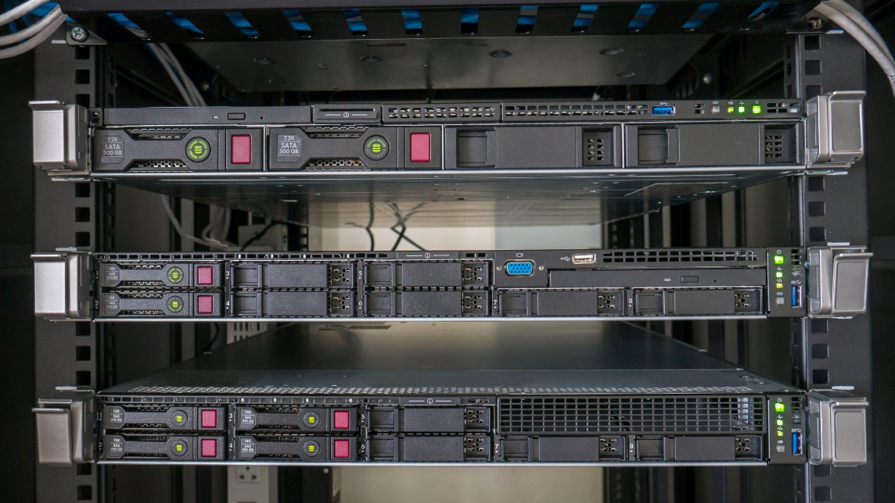

Servers in Data Centers
Rack servers and blade serve
Pros and cons
http://techgenix.com/tower-vs-rack-vs-blade-servers/
https://www.racksolutions.com/news/data-center-optimization/blade-server-vs-rack-server/
Notes:
Rack 機架式較便宜，適合中小型企業、研究單位，散熱管理較容易，每一片 server 安裝在機架中，並連結 switches
Blade 刀鋒式較昂貴，集中式高密度的計算單元，支援熱插拔，散熱較困難，使用者通常需要有很完善的散熱管理，適合資料處理中心

Slide 4
Network Architectures
The different topologies of networks connecting the servers are designed for different purposes
UCSD Fat-Tree data center architecture
Core switches
Aggregate switches
Edge switches
“A Scalable, Commodity Data Center Network Architecture,” in ACM SIGCOMM 2008
Notes:
網路流量有full bisection的性質

Slide 5
Network Architectures
The different topologies of networks connecting the servers are designed for different purposes
Microsoft BCube data center architecture
Level 1 switches
Level 2 switches
“BCube: A High Performance, Server-centric Network Architecture for Modular Data Centers,” in ACM SIGCOMM 2009
Notes:
特別考慮server或switch壞掉的情況，多設計了兩條link連到同一個server
Google 也提了一篇 VL2 在 SIGCOMM 2009

Slide 6
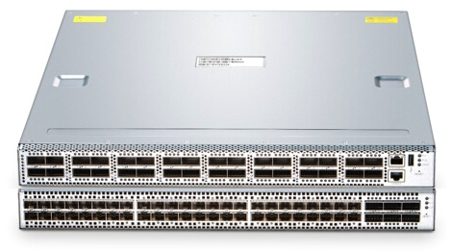
Switches
Each switch has multiple ports
Receive and forward the packets from a port to another port

Slide 7
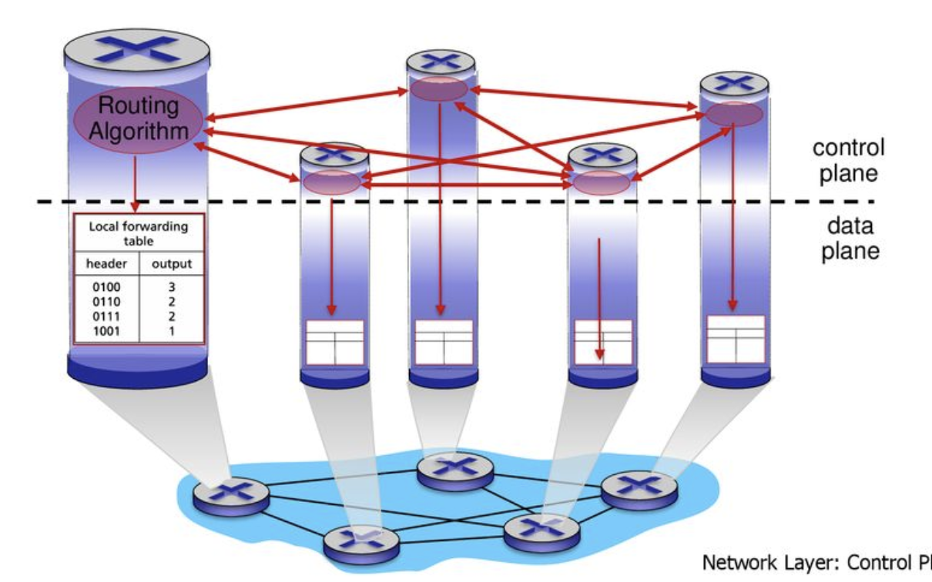
Switches
Switches run distributed routing algorithms to decide routing paths
Each switch maintains a routing table
The routing paths are stored in the table

Slide 8
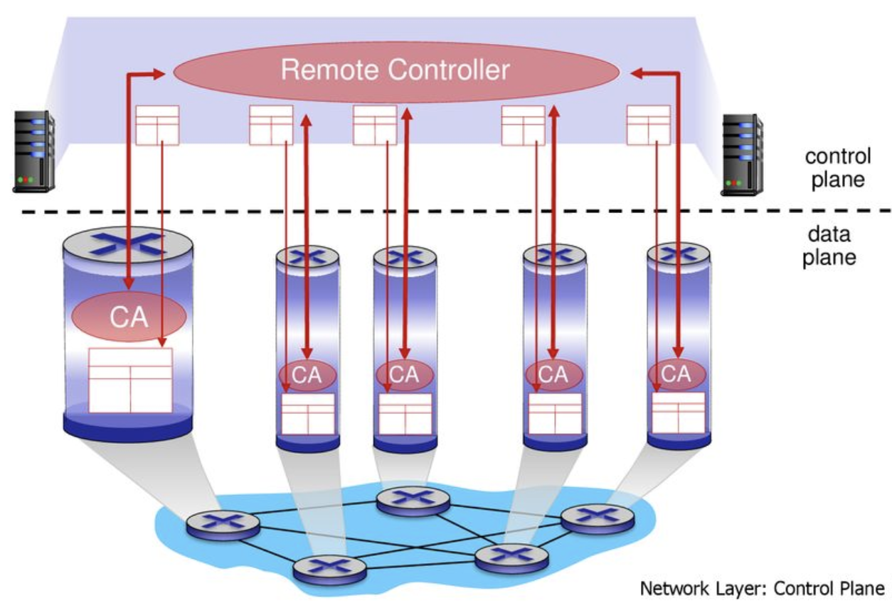
Switches
Distributed algorithms cannot optimize the routing efficiency globally
A centralized controller is introduced – software-defined networking (SDN)

Slide 9
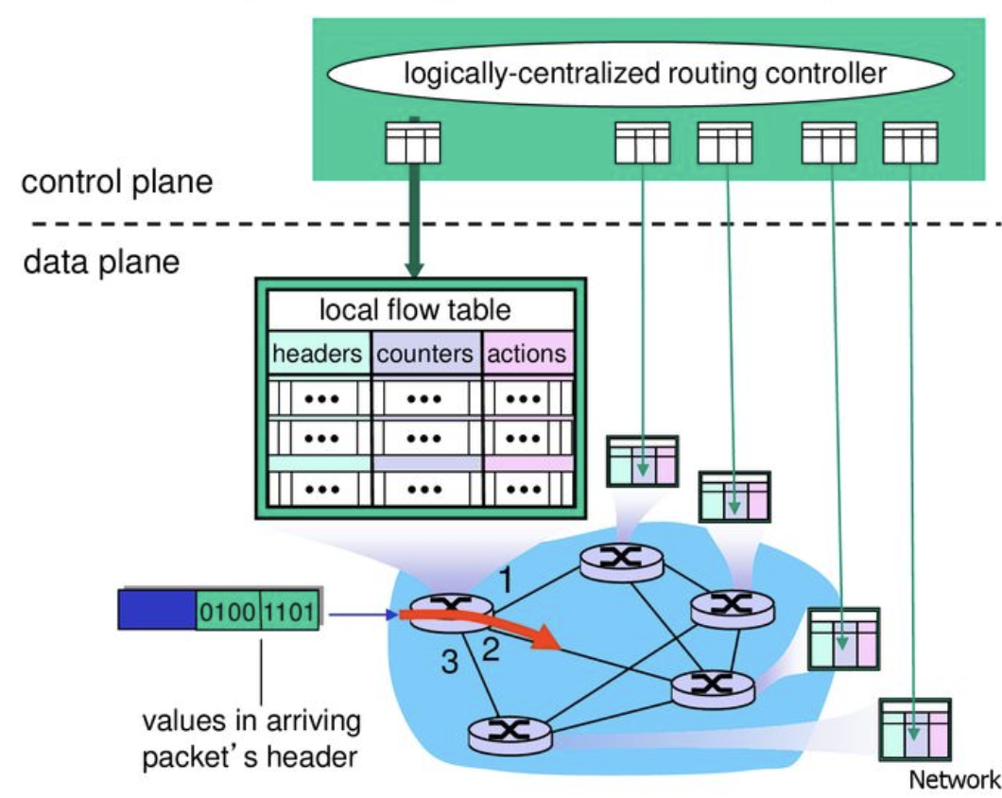
Installing Rules in the Switches

Slide 10
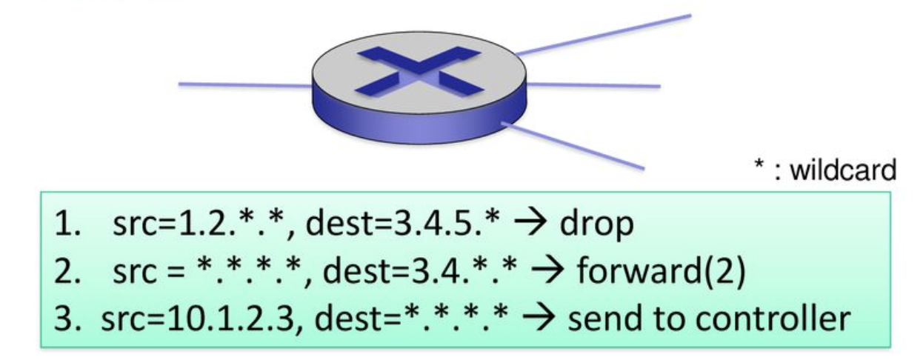
Patterns and Actions in TCAM Ternary (三態) Content Addressable Memory
0 and 1 → 0, 1 and “don’t care”
Pattern: match values in packet header
Actions for matched packet: drop, forward,…
Counters: #packets is matched to each pattern
2
1
3
4

Slide 11
Pros and Cons of TCAM
Compare a search key in parallel against all entries
Report the first matching entry
Allow ‘don’t care’
Dense circuits → expensive, power-hungry, hot
The on-chip TCAM sizes are typically limited to a few thousand entries
Compress or decompose it!
“On the effect of forwarding table size on SDN network utilization,” in IEEE INFOCOM 2014

Slide 12
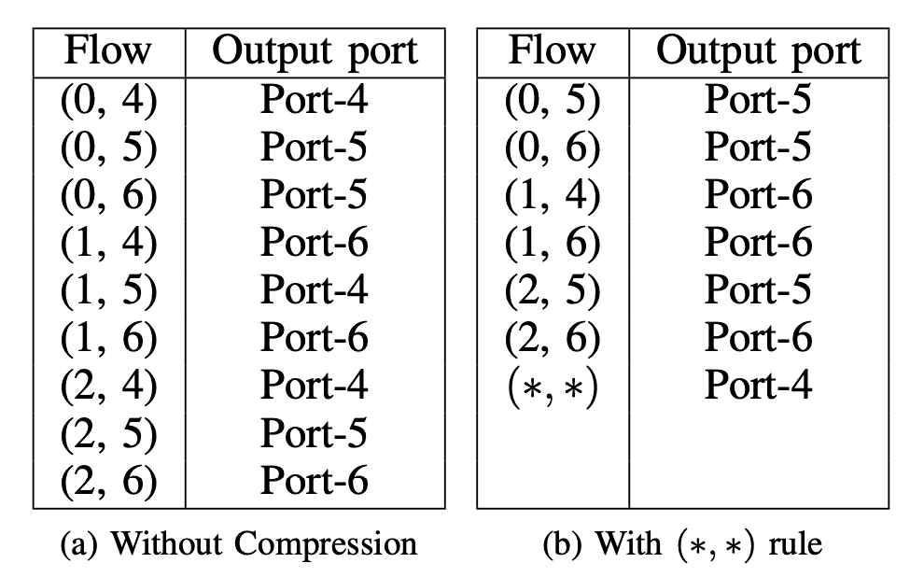
Entry Utilization Minimization
The original table → 9 entries
The modified table by wildcard (*,*) → 7 entries

Slide 13
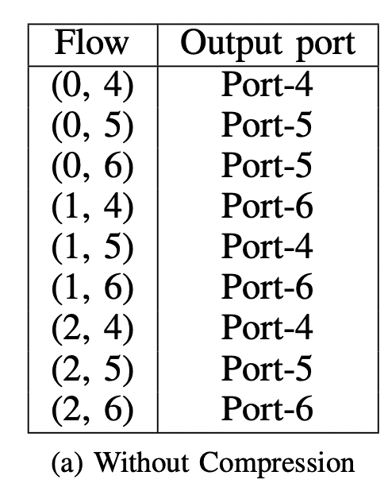
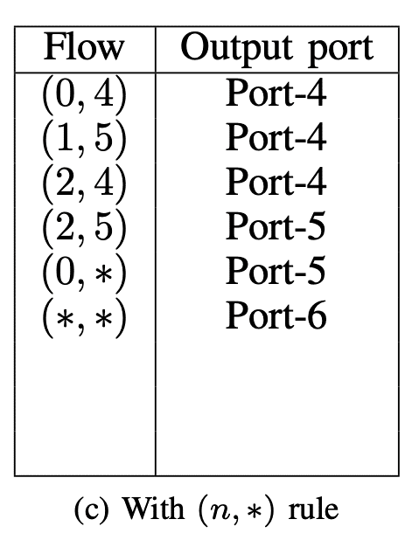
Entry Utilization Minimization
The original table → 9 entries
The modified table by wildcard (n,*) → 6 entries

Slide 14
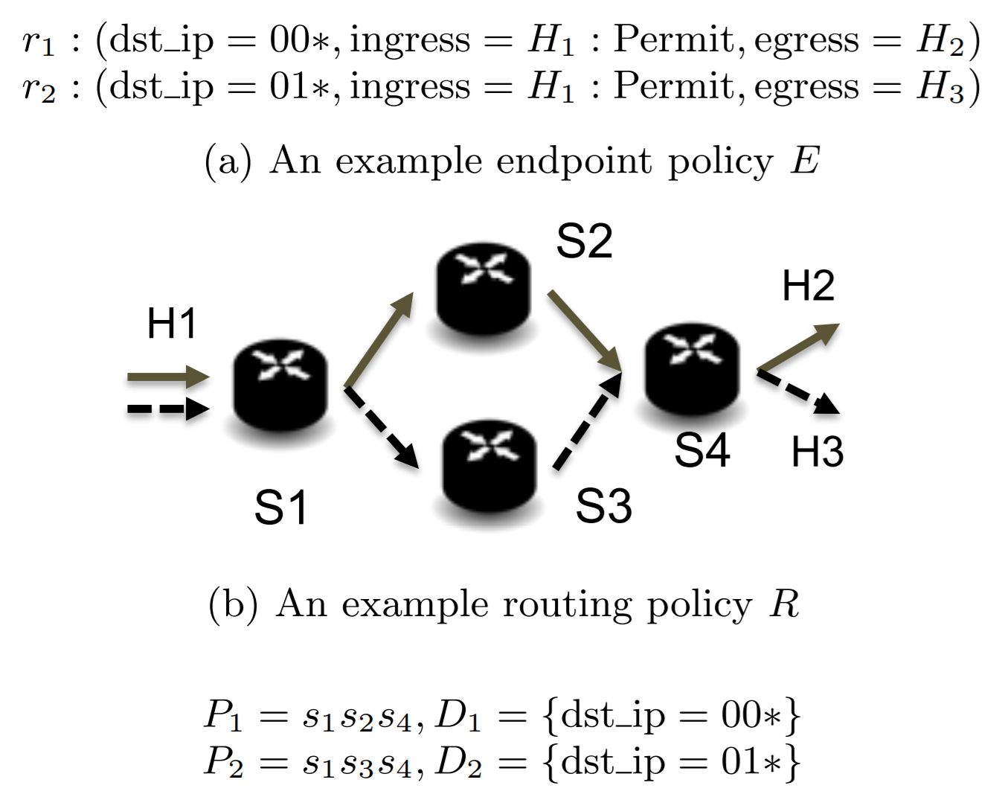
“One Big Switch” Abstraction in SDN

Slide 15
Access control policy in the table Prefix or Exact Matching
Rule | Source IP | Destination IP | Action
R1 | 0* | 00 | Permit
R2 | 01 | 1* | Permit
R3 | * | 11 | Drop
R4 | 11 | * | Permit
R5 | 10 | 0* | Permit
R6 | * | * | Drop

Slide 16
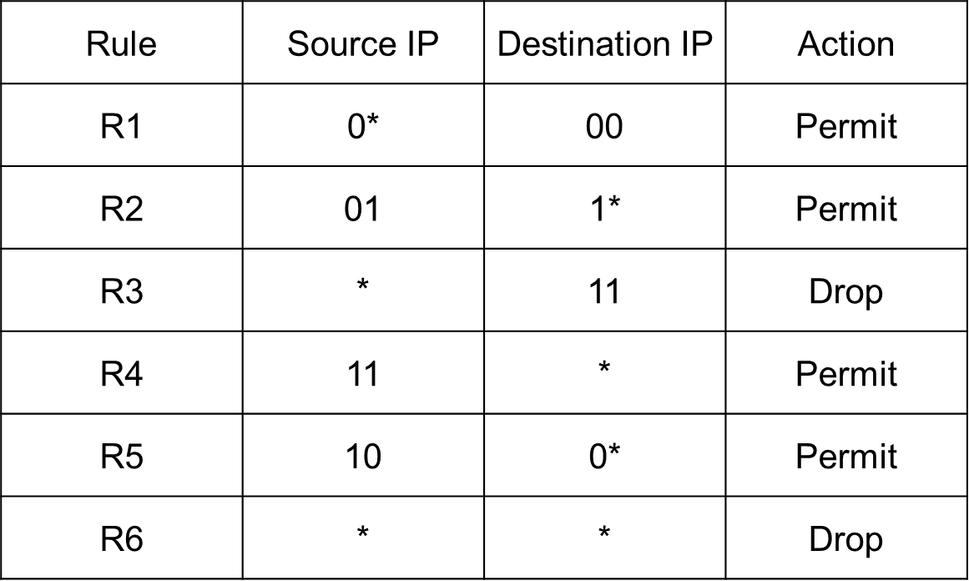
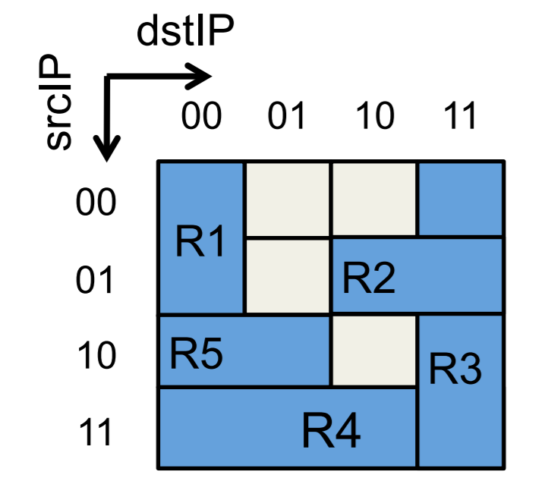
Rectangular representation

Slide 17
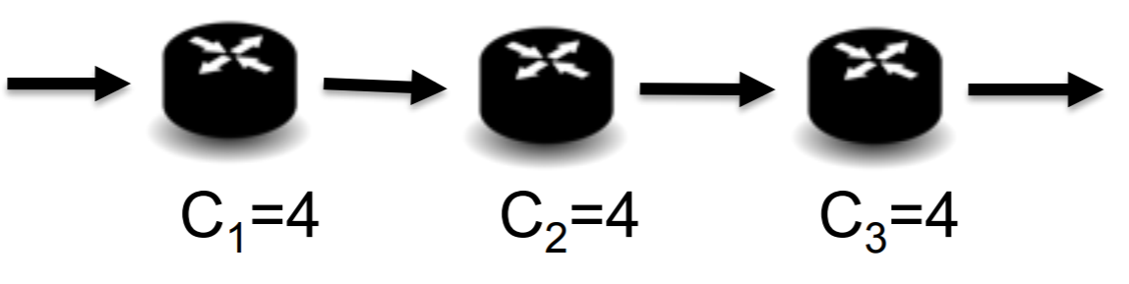
Implementation of “One Big Switch” Abstraction
Limited capacity of a single switch e.g., capacity = 4 but # rules = 6
Multiple switches are regarded as a big switch e.g., total capacity = 4 x 3 = 12

Slide 18
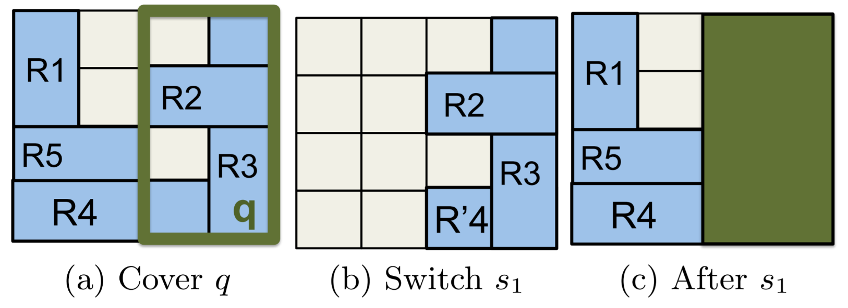
Placing Rules Along a Path
Cover Phase:
Find a rectangle and identify the internal rules (e.g., R2, R3) and overlapping rules (R4, R6)

Slide 19
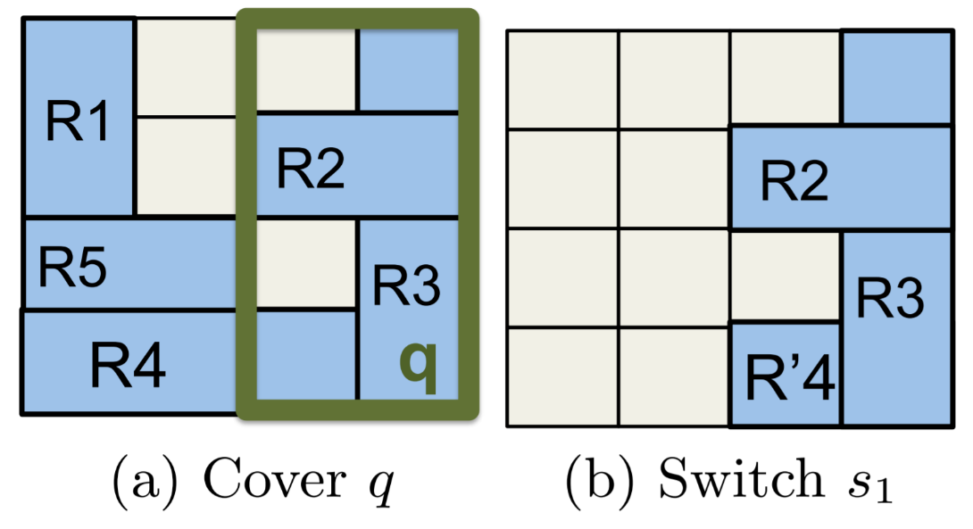
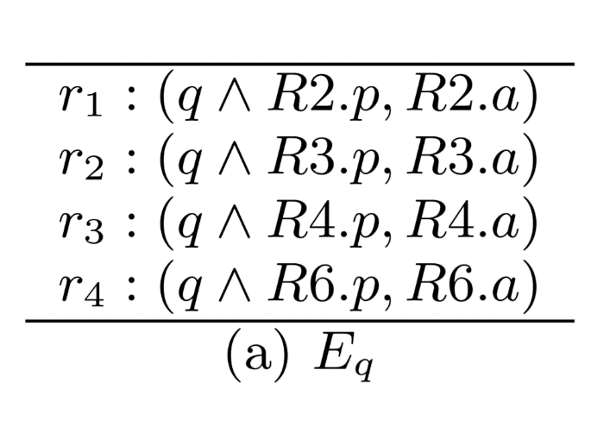
Placing Rules Along a Path
Pack Phase:
Place the rules on the current switch (e.g., the first switch)

Slide 20

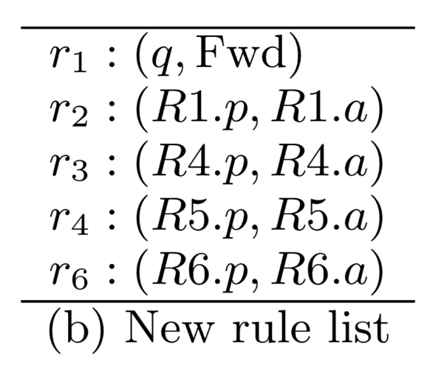
Placing Rules Along a Path
Replace Phase
Rewrite the rules to avoid re-processing the packets in the rectangle
5

Slide 21
Drawback
Additional rules to avoid re-processing the packets in the rectangle
Could be multiple rectangles
5

Slide 22
Programming Project #3: Placing Rules Along a Path
Input:
Numbers of switches
IDs and capacities of switches
Source and destination
Rules
Procedure:
Cover, pack, and replace phase
Output:
The shortest routing path
The rules in each switches
The grade is inversely proportional to the number of switches with rules (except routing)

Slide 23
Programming Project #3: Placing Rules Along a Path
Input:
Numbers of switches
IDs and capacities of switches
Source and destination
Rules
Procedure:
Cover, pack, and replace phase
Output:
The shortest routing path
The rules in each switches
The grade is inversely proportional to the number of switches with rules (except routing)
要棄選了嗎?

Slide 24
Programming Project #3: Cost-Efficient Covering & Packing
Input:
Numbers of switches
IDs and capacities of switches
Source and destination
Procedure:
Cover, pack, and replace phase
Output:
The shortest routing path
The rules in each switches
The algorithm is given You have to implement the algorithm

Slide 25
Find the Path
Given: A pair of an ingress switch and an egress switch
Find the shortest path by Dijkstra Algorithm
For tie breaking, we give the priority to the one:
1. with the smaller hop count
2. with the smaller switch ID in the sequence
2
5
3
2
4
3
2
6
4
3

Slide 26
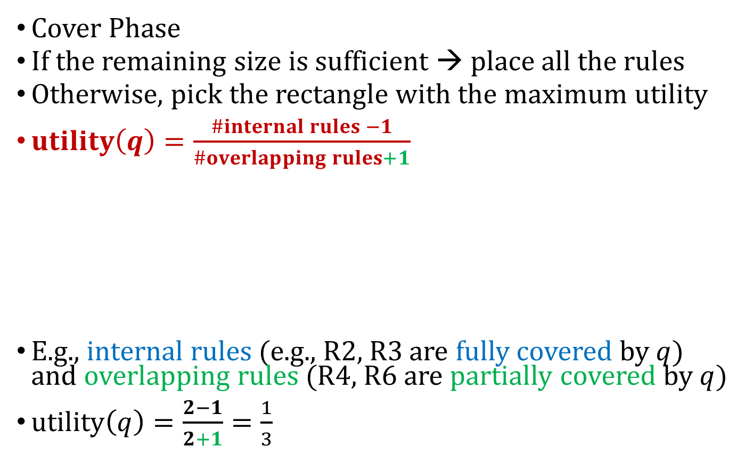
The Algorithm for Placing Rules Along a Path
Cover Phase
If the remaining size is sufficient → place all the rules
Otherwise, pick the rectangle with the maximum utility
$utility\left(q\right)=\frac{\#internal rules −1}{\#overlapping rules+1}$
E.g., internal rules (e.g., R2, R3 are fully covered by $q$) and overlapping rules (R4, R6 are partially covered by $q$)
$utility\left(q\right)=\frac{2−1}{2+1}=\frac{1}{3}$

Slide 27
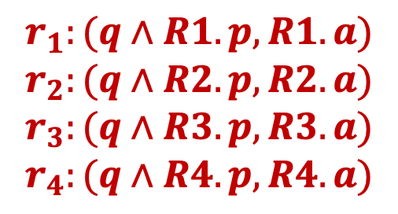
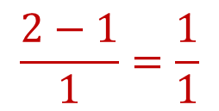
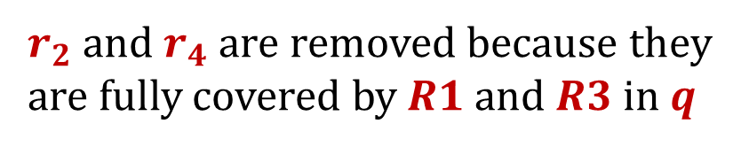
Remark for Overlapping Rules
Assume that the default rule is R4 (*, *, Drop)
R2 and R4 are not considered as overlapping rules in the following red rectangle
$r_{2}$ and $r_{4}$ are removed because they are fully covered by $R1$ and $R3$ in $q$
R1
$$\frac{2−1}{1}=\frac{1}{1}$$
R2
$$r_{1}:(q∧R1.p, R1.a)$$
$$r_{2}:(q∧R2.p, R2.a)$$
$$r_{3}:(q∧R3.p, R3.a)$$
$$r_{4}:(q∧R4.p, R4.a)$$
R3

Slide 28
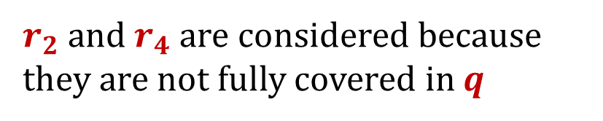
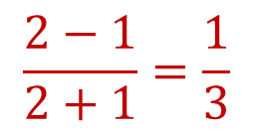
Remark for Overlapping Rules
Assume that the default rule is R4 (*, *, Drop)
In contrast, R2 and R4 are considered as overlapping rules in the following red rectangle
$r_{2}$ and $r_{4}$ are considered because they are not fully covered in $q$
R1
$$\frac{2−1}{2+1}=\frac{1}{3}$$
R2
$$r_{1}:(q∧R1.p, R1.a)$$
$$r_{2}:(q∧R2.p, R2.a)$$
$$r_{3}:(q∧R3.p, R3.a)$$
$$r_{4}:(q∧R4.p, R4.a)$$
R3

Slide 29
Choose the Rectangle
You need to examine all the possible rectangles
#rows = 1, 2, 4, 8, …
#columns = 1, 2, 4, 8, …

Slide 30
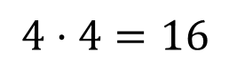
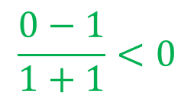
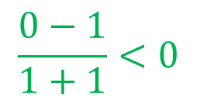
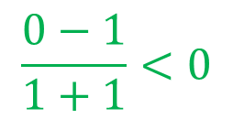
Choose the Rectangle
You need to examine all the possible rectangles
We only consider the rectangle with utility > 0
$$\frac{0−1}{1+1}<0$$
$$\frac{0−1}{1+1}<0$$
$$\frac{0−1}{1+1}<0$$
We don’t use them
$$4⋅4=16$$

Slide 31
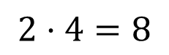
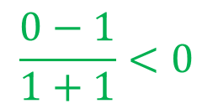
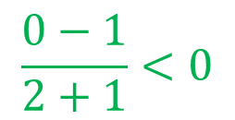

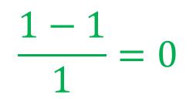
Choose the Rectangle
You need to examine all the possible rectangles
We only consider the rectangle with utility > 0
$$\frac{1−1}{1}=0$$
$$\frac{0−1}{1+1}<0$$
$$\frac{0−1}{2+1}<0$$
$$\frac{0−1}{1+1}<0$$
$$2⋅4=8$$
We don’t use them

Slide 32
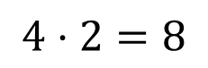
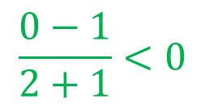
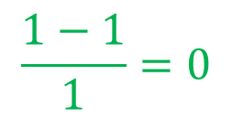
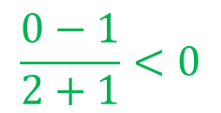
Choose the Rectangle
You need to examine all the possible rectangles
We only consider the rectangle with utility > 0
$$\frac{0−1}{2+1}<0$$
$$\frac{1−1}{1}=0$$
$$\frac{0−1}{2+1}<0$$
$$4⋅2=8$$
We don’t use them

Slide 33
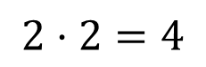
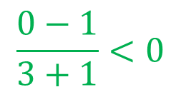
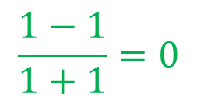

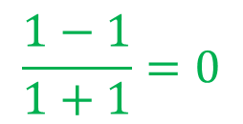
Choose the Rectangle
You need to examine all the possible rectangles
We only consider the rectangle with utility > 0
$$\frac{1−1}{1+1}=0$$
$$\frac{1−1}{2+1}=0$$
$$\frac{1−1}{1+1}=0$$
$$\frac{0−1}{3+1}<0$$
$$2⋅2=4$$
We don’t use them

Slide 34
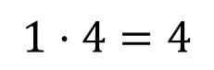




Choose the Rectangle
You need to examine all the possible rectangles
We only consider the rectangle with utility > 0
$$\frac{1−1}{2+1}=0$$
$$\frac{0−1}{3+1}<0$$
$$\frac{0−1}{3+1}<0$$
$$\frac{1−1}{1+1}=0$$
$$1⋅4=4$$
We don’t use them

Slide 35
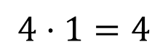




Choose the Rectangle
You need to examine all the possible rectangles
We only consider the rectangle with utility > 0
$$\frac{0−1}{3+1}<0$$
$$\frac{1−1}{2+1}=0$$
$$\frac{1−1}{2+1}=0$$
$$\frac{1−1}{1+1}=0$$
$$4⋅1=4$$
We don’t use them

Slide 36
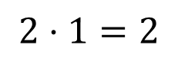
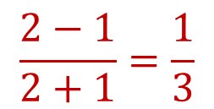

Choose the Rectangle
You need to examine all the possible rectangles
We only consider the rectangle with utility > 0
$$\frac{2−1}{2+1}=\frac{1}{3}$$
$$\frac{2−1}{2+1}=\frac{1}{3}$$
$$2⋅1=2$$

Slide 37
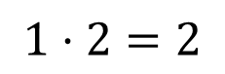

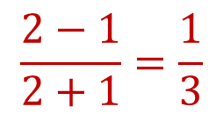
Choose the Rectangle
You need to examine all the possible rectangles
We only consider the rectangle with utility > 0
$$\frac{2−1}{2+1}=\frac{1}{3}$$
$$\frac{2−1}{2+1}=\frac{1}{3}$$
$$1⋅2=2$$

Slide 38
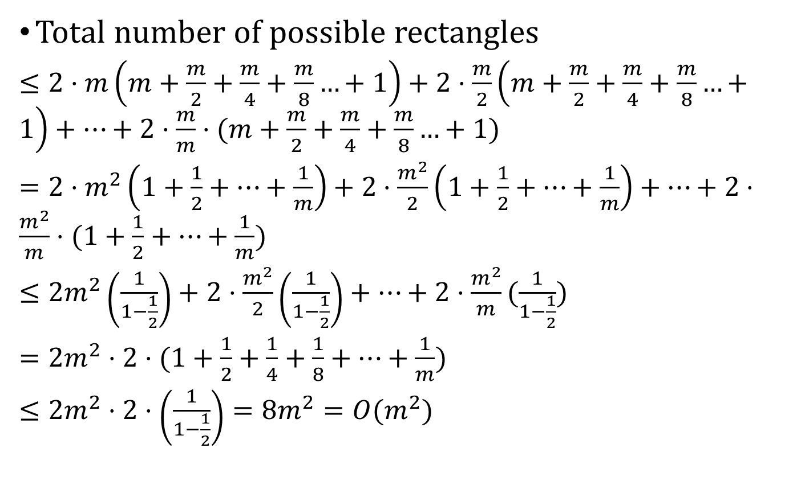
Number of Examined Rectangles
Total number of possible rectangles
$≤2⋅m\left(m+\frac{m}{2}+\frac{m}{4}+\frac{m}{8}…+1\right)+2⋅\frac{m}{2}\left(m+\frac{m}{2}+\frac{m}{4}+\frac{m}{8}…+1\right)+…+2⋅\frac{m}{m}⋅(m+\frac{m}{2}+\frac{m}{4}+\frac{m}{8}…+1)$
$=2⋅m^{2}\left(1+\frac{1}{2}+…+\frac{1}{m}\right)+2⋅\frac{m^{2}}{2}\left(1+\frac{1}{2}+…+\frac{1}{m}\right)+…+2⋅\frac{m^{2}}{m}⋅(1+\frac{1}{2}+…+\frac{1}{m})$
$≤2m^{2}\left(\frac{1}{1−\frac{1}{2}}\right)+2⋅\frac{m^{2}}{2}\left(\frac{1}{1−\frac{1}{2}}\right)+…+2⋅\frac{m^{2}}{m}(\frac{1}{1−\frac{1}{2}})$
$=2m^{2}⋅2⋅(1+\frac{1}{2}+\frac{1}{4}+\frac{1}{8}+…+\frac{1}{m})$
$≤2m^{2}⋅2⋅\left(\frac{1}{1−\frac{1}{2}}\right)=8m^{2}=O(m^{2})$

Slide 39
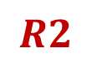



Choose the Rectangle
Find the rectangle with the maximum utility
For tie breaking, we give the priority to the one
1. with the more internal rule IDs, then…
2. with the smaller area size, and then
3. with the smaller internal rule ID in the sequence
$$R1$$
$$R1$$
$$R2$$
$$R4$$

Slide 40
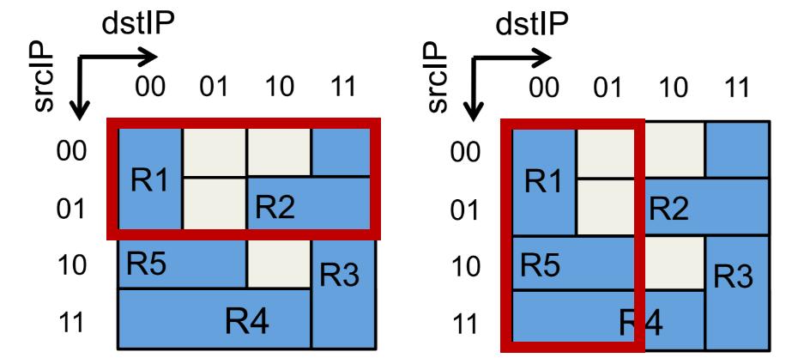

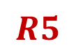


Choose the Rectangle
Find the rectangle with the maximum utility
For tie breaking, we give the priority to the one
1. with the more internal rule IDs, then…
2. with the smaller area size, and then
3. with the smaller internal rule ID in the sequence
$$R2$$
$$R5$$
$$X$$
$$X$$

Slide 41
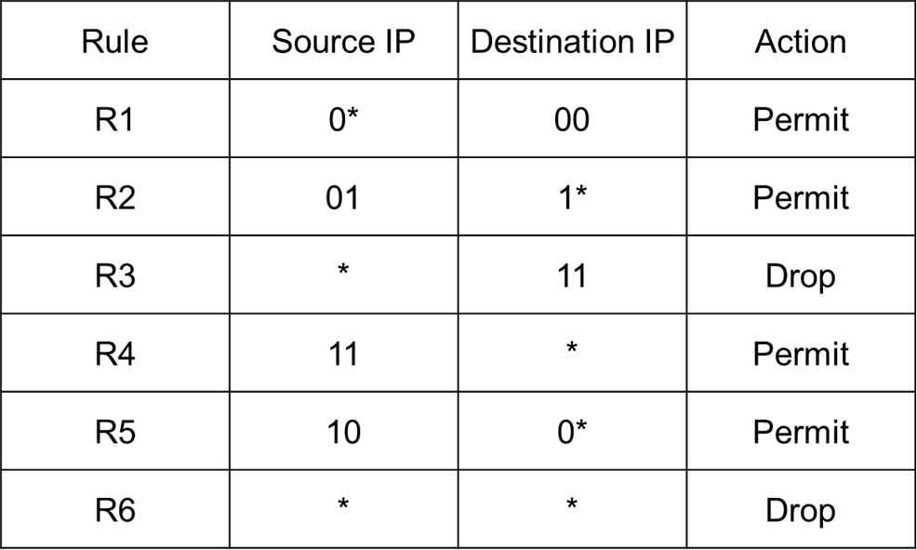


Example
Find the rectangle with the maximum utility
Rule | src | dst | action
r1 | 0* | 00 | Permit
r2 | 01 | 1* | Permit
r3 | 0* | 11 | Drop
r4 | 0* | * | Drop
$$q1$$
$$r_{1}:(q1∧R1.p, R1.a)$$
$$r_{2}:(q1∧R2.p, R2.a)$$
$$r_{3}:(q1∧R3.p, R3.a)$$
$$r_{4}:(q1∧R6.p, R6.a)$$

Slide 42

Example
Rewrite the remaining rules
Rule | src | dst | action
r1 | 0* | * | Fwd
r2 | * | 11 | Drop
r3 | 11 | * | Permit
r4 | 10 | 0* | Permit
r5 | * | * | Drop
$$r_{1}:(q1, Fwd)$$
$$r_{2}:(R3.p, R3.a)$$
$$r_{3}:(R4.p, R4.a)$$
$$r_{4}:\left(R5.p, R5.a\right)$$
$$r_{5}:(R6.p, R6.a)$$
$$q1$$

Slide 43




Example
Regard the remaining rules as a new set of rules
Rule | src | dst | action
R1 | 0* | * | Fwd
R2 | * | 11 | Drop
R3 | 11 | * | Permit
R4 | 10 | 0* | Permit
R5 | * | * | Drop
$$R1$$
$$R2$$
$$R4$$
$$R3$$

Slide 44


Example
Find the rectangle with the maximum utility
Rule | src | dst | action
R1 | 0* | * | Fwd
R2 | * | 11 | Drop
R3 | 11 | * | Permit
R4 | 10 | 0* | Permit
R5 | * | * | Drop
$$utility\left(q_{2}\right)$$
$$=\frac{2−1}{2+1}=\frac{1}{3}$$
$$R1$$
$$R2$$
$$R4$$
$$q2$$
$$R3$$

Slide 45


Example
Find the rectangle with the maximum utility
Rule | src | dst | action
R1 | 0* | * | Fwd
R2 | * | 11 | Drop
R3 | 11 | * | Permit
R4 | 10 | 0* | Permit
R5 | * | * | Drop
Rule | src | dst | action
r1 | 1* | 11 | Drop
r2 | 11 | * | Permit
r3 | 10 | 0* | Permit
r4 | 1* | * | Drop
$$R1$$
$$R2$$
$$r_{1}:(q2∧R2.p, R2.a)$$
$$r_{2}:(q2∧R3.p, R3.a)$$
$$r_{3}:(q2∧R4.p, R4.a)$$
$$r_{4}:\left(q2∧R5.p, R5.a\right)$$
$$R4$$
$$q2$$
$$R3$$

Slide 46


Example
Rewrite the remaining rules
Rule | src | dst | action
R1 | 0* | * | Fwd
R2 | * | 11 | Drop
R3 | 11 | * | Permit
R4 | 10 | 0* | Permit
R5 | * | * | Drop
Rule | src | dst | action
r1 | 1* | * | Fwd
r2 | 0* | * | Fwd
$r_{3}$ and $r_{4}$ are removed because they are fully covered by $r_{1}$ and $r_{2}$
$$R1$$
$$R2$$
$$r_{1}:(q2, Fwd)$$
$$r_{2}:(R1.p, R1.a)$$
$$r_{3}:(R2.p, R2.a)$$
$$r_{4}:\left(R5.p, R5.a\right)$$
$$R4$$
$$q2$$
$$R3$$

Slide 47

Example
Rewrite the remaining rules
Rule | src | dst | action
R1 | 0* | * | Fwd
R2 | * | 11 | Drop
R3 | 11 | * | Permit
R4 | 10 | 0* | Permit
R5 | * | * | Drop
Rule | src | dst | action
r1 | 1* | * | Fwd
r2 | 0* | * | Fwd
$r_{3}$ and $r_{4}$ are removed because they are fully covered by $r_{1}$ and $r_{2}$
$$R1$$
$$R2$$
$$r_{1}:(q2, Fwd)$$
$$r_{2}:(R1.p, R1.a)$$
$$R4$$
$$q2$$
$$R3$$

Slide 48
Discussion
The related problems are NP-hard
You cannot find an efficient optimal algorithm for these problems unless NP = P
There are many heuristic algorithms
“Too many SDN rules? Compress them with MINNIE,” in IEEE ICC 2015
“Optimizing the One Big Switch Abstraction in Software-Defined Networks,” in ACM CoNext 2013
“Palette: Distributing tables in software-defined networks,” in IEEE INFOCOM 2013

Slide 49

Input Sample: input.txt
Format:
#Bits
IngressID1 EgressID2
#switches
switchID capacity
#links
switchID1 switchID2 weight
…
#rules
SrcIP1 DstIP2 action
…

Slide 50



Input Sample: input.txt
2
0 2
3
0 4
1 4
2 4
2
0 1 1
1 2 1
6
0* 00 Permit
01 1* Permit
* 11 Drop
11 * Permit
10 0* Permit
* * Drop
$$C_{0}=4$$
$$C_{1}=4$$
$$C_{2}=4$$

Slide 51

Output Sample: output.txt
Rule | src | dst | action
r1 | 0* | 00 | Permit
r2 | 01 | 1* | Permit
r3 | 0* | 11 | Drop
r4 | 0* | * | Drop
Format:
#tables(#switchesOfPath)
switchID1 #entriesOfTable1
SrcIP1 DstIP2 action
…
switchID2 #entriesOfTable2
SrcIP1 DstIP2 action
…
PS: You need to return all the tables of switches on the path even if the number of entries of the table is empty
Rule | src | dst | action
r1 | 1* | 11 | Drop
r2 | 11 | * | Permit
r3 | 10 | 0* | Permit
r4 | 1* | * | Drop
Rule | src | dst | action
r1 | 1* | * | Fwd
r2 | 0* | * | Fwd

Slide 52
Output Sample: output.txt
Rule | src | dst | action
r1 | 0* | 00 | Permit
r2 | 01 | 1* | Permit
r3 | 0* | 11 | Drop
r4 | 0* | * | Drop
3
0 4
0* 00 Permit
01 1* Permit
0* 11 Drop
0* * Drop
1 4
1* 11 Drop
11 * Permit
10 0* Permit
1* * Drop
2 2
1* * Fwd
0* * Fwd
Rule | src | dst | action
r1 | 1* | 11 | Drop
r2 | 11 | * | Permit
r3 | 10 | 0* | Permit
r4 | 1* | * | Drop
Rule | src | dst | action
r1 | 1* | * | Fwd
r2 | 0* | * | Fwd

Slide 53
Note
Superb deadline: 12/3 Thu (視情況延期)
Deadline: 12/10 Thu (視情況延期)
Submit your code to E-course2
Demonstrate your code in 工院1館 401B
C Source code
Show a good programming style

Slide 54

Appendix: Entry Utilization Minimization Non-prefix Compression
The original table → 9 entries
The modified table by wildcard (*,n) → 6 entries

Slide 55

Appendix: Entry Utilization Minimization Non-prefix Compression
The original table → 9 entries
The minimal table → 5 entries

